Slide 1
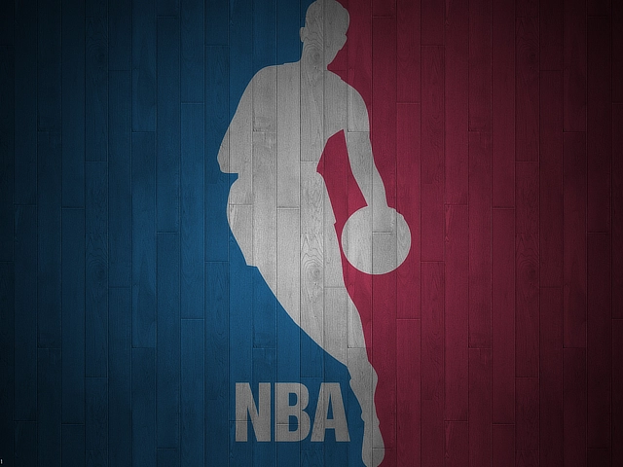
WHY ARE CERTAIN BASKETBALL TEAMS SUCCESSFUL
Luzhou Shen, Mackenzie Chen

Slide 2
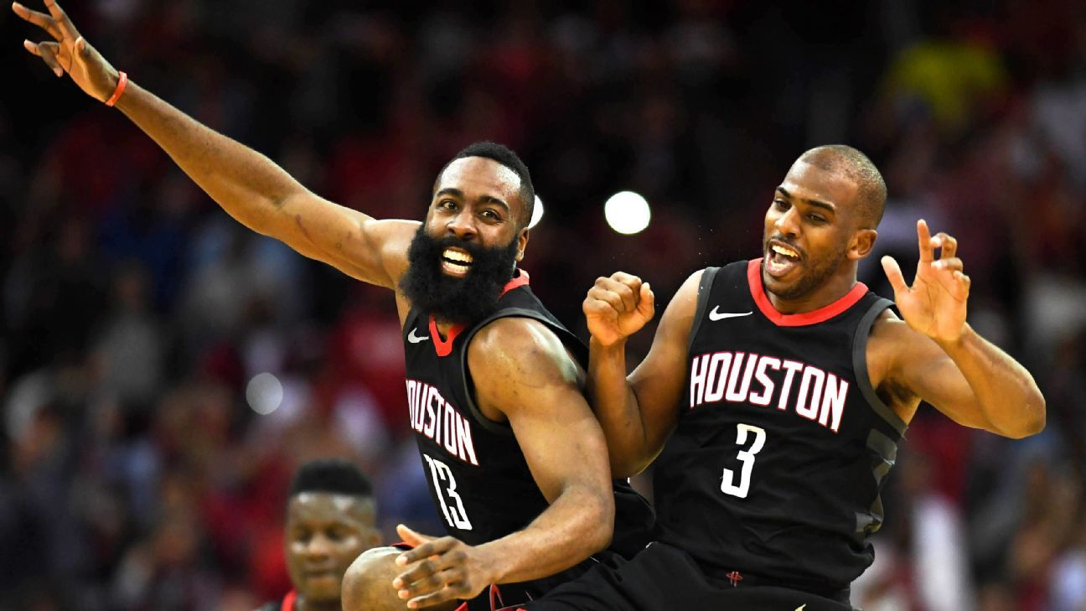
Objective and Method
Purpose: understand what contributes to the success of certain players or teams
Approach: utilize NBA play-by-play data to provide analytics
Offer insights into optimal strategies for leveraging star player dynamics by analyzing their +/- (Plus/minus)
Determine if the star player has improved the performance of his teammates by comparing changes in their shooting percentages

Slide 3
Method Explanation
For Example | Both Stars | Star A only | Star B only | No star | Total
+/- per min | 6 | 2 | 3 | -0.5
Star playing time |  | 36 | 24
“Together” min | 24 | 12 | 0
“Together” (+/-per min) * min | 6*24 | 2*12 | 0 | -0.5*12 | 162
“Separate” min | 12 | 24 | 12 | 0
“Separate” (+/-per min) * min | 6*12 | 2*24 | 3*12 | 0 | 156
+/- per min: Difference of scored points against the other team in that deployment
“Together”: Prioritize deploying both players simultaneously
(The star player who plays longer will have time that he’s the only star playing)
“Separate”: Prioritize deploying star players separately
(Star players usually play more than 48 min per game, so there’ll be time for them to
play together)
Calculate and compare the total +/- per game to decide whether the team should deploy the star players together or separately

Slide 4
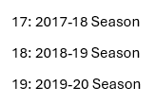
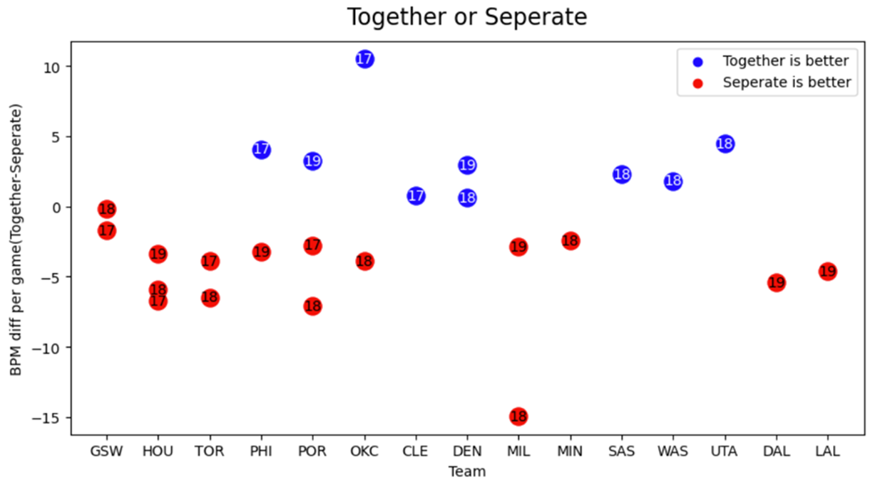
How does a team best use a “power partnership”?
Red docs: Separating star players' court time, allowing them to lead the team at different intervals
For example: James Harden & Chris Paul, LeBron James & Anthony Davis, Giannis Antetokounmpo & Khris Middleton, etc.
Blue docs: a pair of star players is on the court simultaneously can produce better results
For example: Russell Westbrook & Paul George, Nikola Jokic & Jamal Murray, Donovan Mitchell & Rudy Gobert, etc.
Conclusion: Usually, a combination of frontcourt and guard players often performs better when playing together on the basketball court primarily stems from the complementary skills and tactical versatility required in basketball.
Notes:
In this chart, The y-axis represents the difference in points between using “together” and using “separate”.
Blue docs indicate that the team performs better when they are on the court together. Red docs mean that separate them is the better choice. For example, James Harden and Chris Paul both need the ball on their hands to maximize their impact. When they're both on the floor at the same time, there's going to be issues with ball distribution. Rockets' head coach Mike D'Antoni utilizes a rotation system to ensure that at least one star is on the court at any time, keeping the team's offense efficient. In this chart, we can see that the red points are almost all combinations of a frontcourt player with a guard player, while the blue points are mostly players with similar positions. Therefore, it's more sensible for a team to choose a combination of a frontcourt and a guard player. Our further analysis focuses on why certain pairings of stars are less effective together and finding tactical arrangements that suit them.

Slide 5
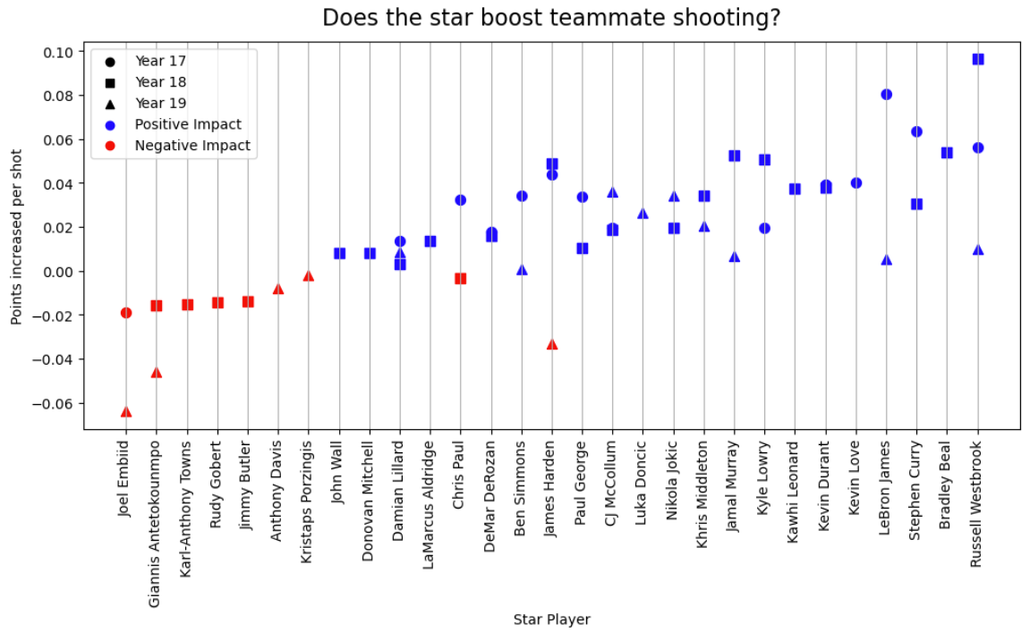
Do great players make their teammates better?
The change in the average points per attempt of the star player's teammates when he is on the court.
Blue docs: the star player can improve his teammates' shooting performance
For example: James Harden (in 2017-18, 2018-19 season), Russell Westbrook, Stephen Curry, Luka Doncic, etc.
Red docs: When this star player on the field, his teammates shoot worse
For example: Joel Embiid, Giannis Antetokounmpo, Rudy Gobert, Anthony Davis, etc.
Conclusion: most star players make their teammates perform better
Notes:
This graph shows the change in the number of points a teammate can score per shot with and without the star player on the court. Blue points indicate star players who can make their teammates' shots more efficient. For example, ball-dominant players like James Harden, Luka Dončić, Russell Westbrook, and LeBron James, when they drive, they face double teams or even more defenders. This leaves their teammates open, and through their excellent passing ability, they can pass the ball to an open teammate, making it easier for them to score. Our further analysis aims to understand why some stars make their teammates' shooting performance worse like Embiid, Giannis, AD, and to help Darvin Ham figure out how to use Anthony Davis and the tactics that suit him best.

